Slide 1
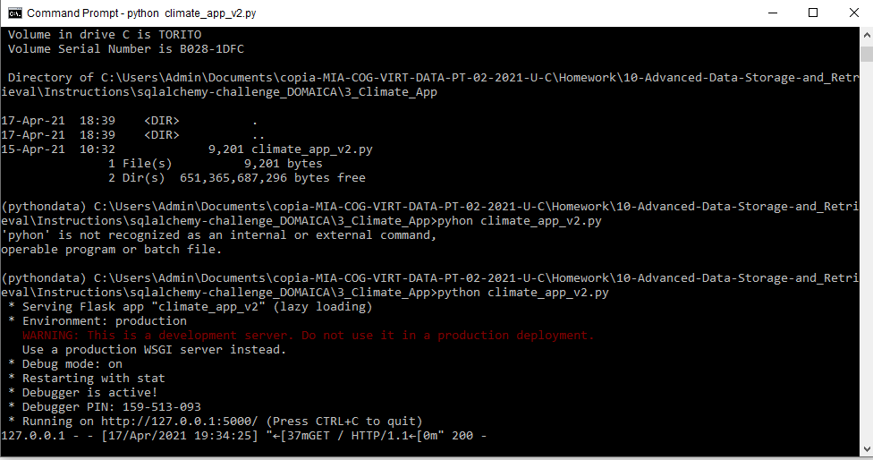

Slide 2
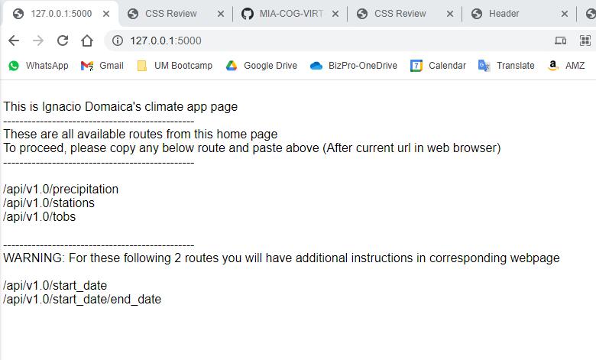
http://127.0.0.1:5000/

Slide 3
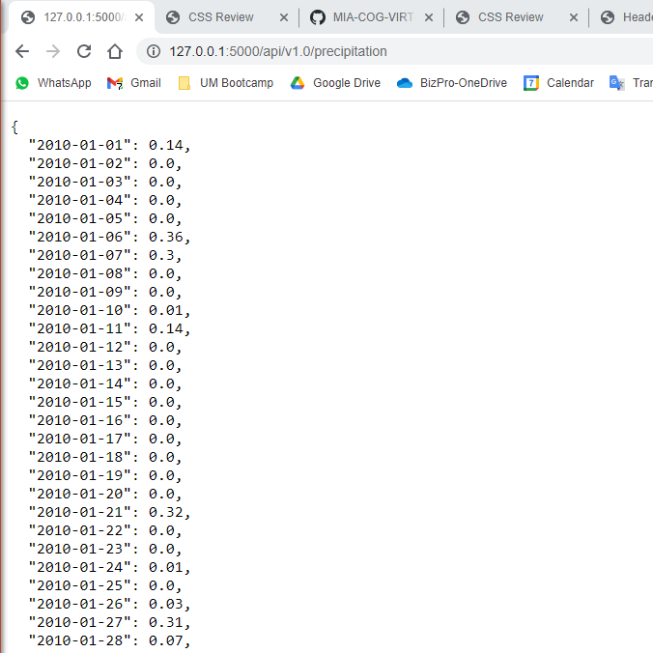
ROUTES
http://127.0.0.1:5000/api/v1.0/precipitation

Slide 4
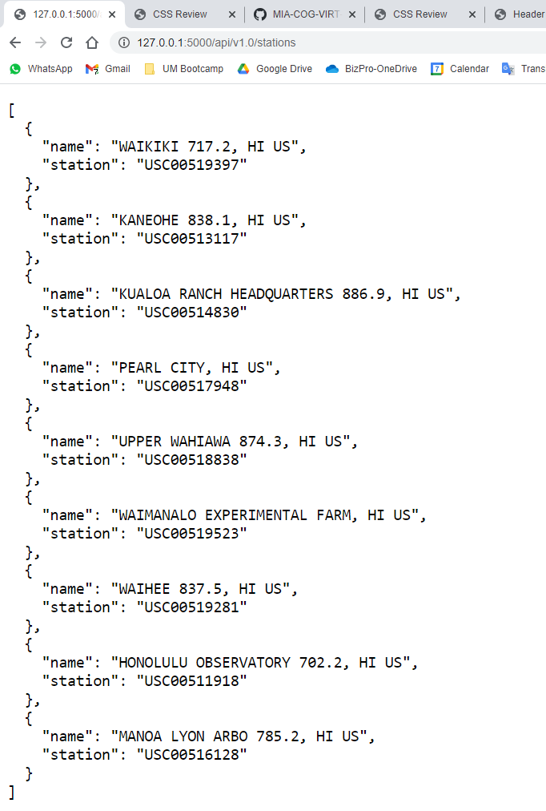
ROUTES
http://127.0.0.1:5000/api/v1.0/stations

Slide 5
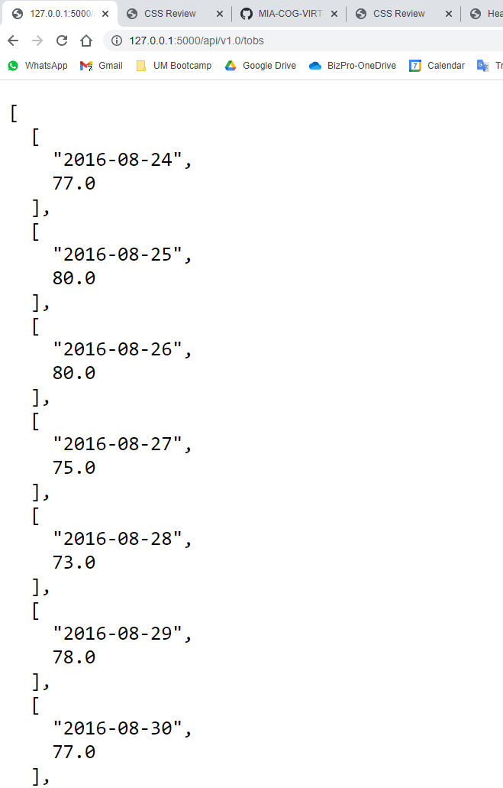
ROUTES
http://127.0.0.1:5000/api/v1.0/tobs

Slide 6
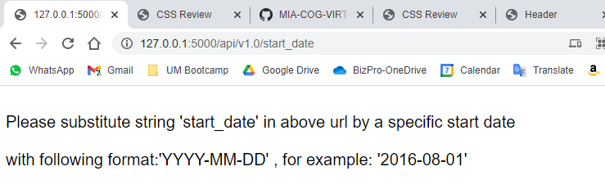
ROUTES
http://127.0.0.1:5000/api/v1.0/start_date

Slide 7
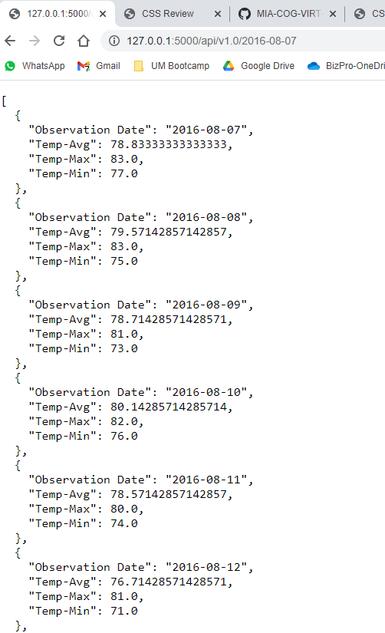
ROUTES
http://127.0.0.1:5000/api/v1.0/2016-08-07

Slide 8
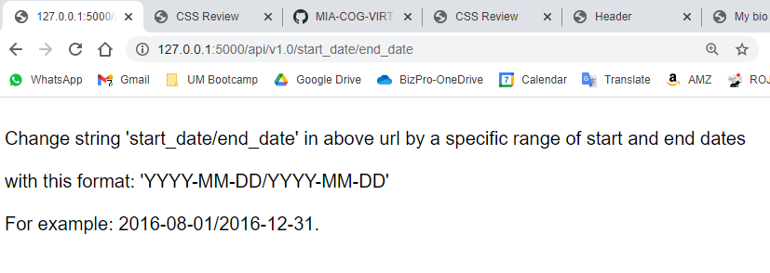
ROUTES
http://127.0.0.1:5000/api/v1.0/start_date/end_date

Slide 9
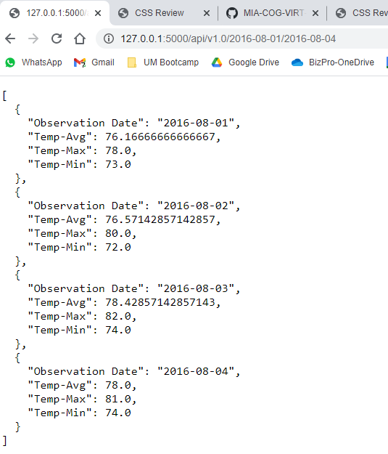
ROUTES
http://127.0.0.1:5000/api/v1.0/2016-08-01/2016-08-04

Slide 10
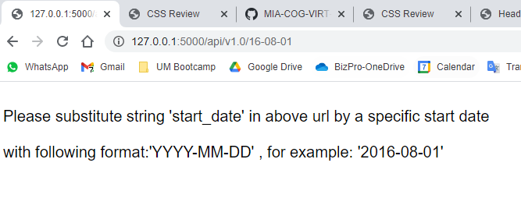

ERROR INPUT
http://127.0.0.1:5000/api/v1.0/16-08-01

